Slide 1
Multi-Period Optimization for Power Distribution Systems with Battery Storage
Aryan Ritwajeet Jha
Notes:
Remember to hit the reset button to make sure all the page elements react properly.
There are 20 different layouts that you can choose from.

Slide 2

Multi-Period D-OPF simulation of a grid with DERs and Battery Storage
Currently it’s a series of single period D-OPFs, being solved for greedily.
Battery State of Charge (SOC) is ‘memorized’ by the grid after every time step, so a meaningful simulation is run for ‘Multi-time period’, even though the optimization itself is NOT done over the whole horizon.
Naïve Brute-Force approach to MPOPF being implemented (Solve for the full problem for the full horizon in one go).

Slide 3
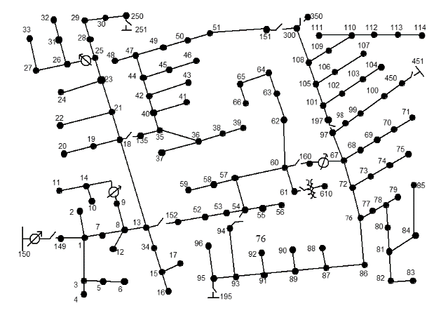
The Network
Current problem statement:
Single-phase power distribution network (Here, the IEEE123 Node Test System)

Slide 4
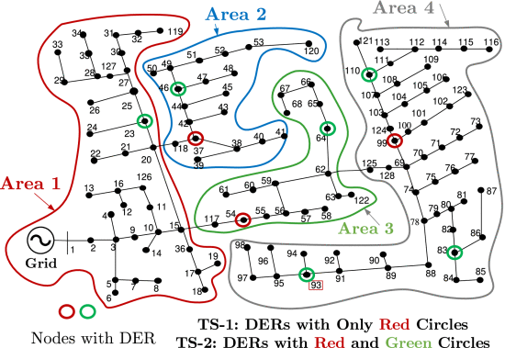
The Network
Current problem statement:
Divide the network into several areas in order to solve for their Optimal Power Flow solutions separately, with exchange of boundary variables after every ‘macro-iteration’.

Slide 5
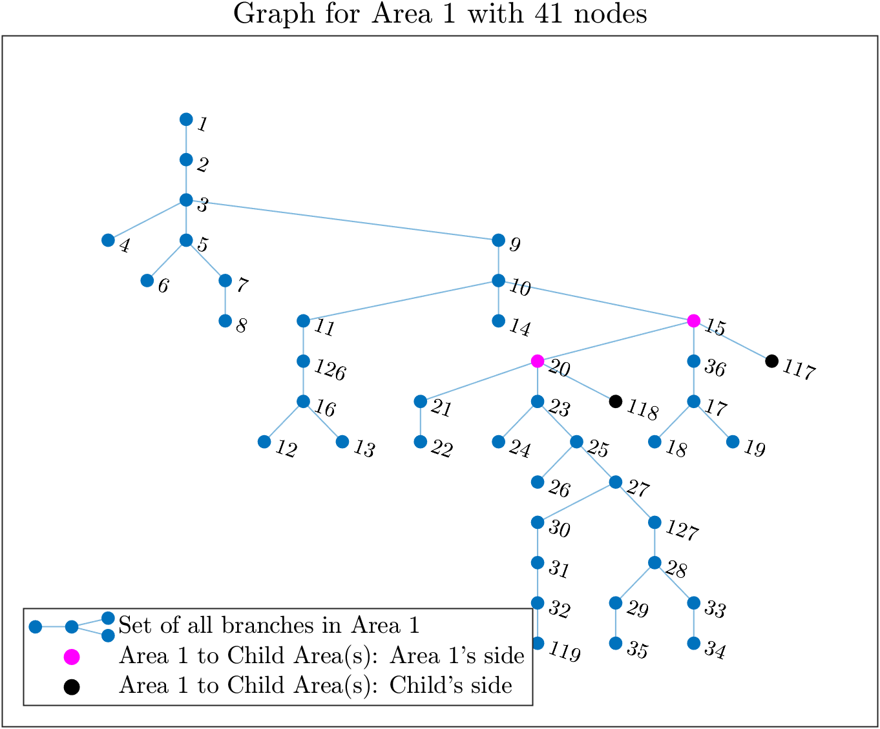
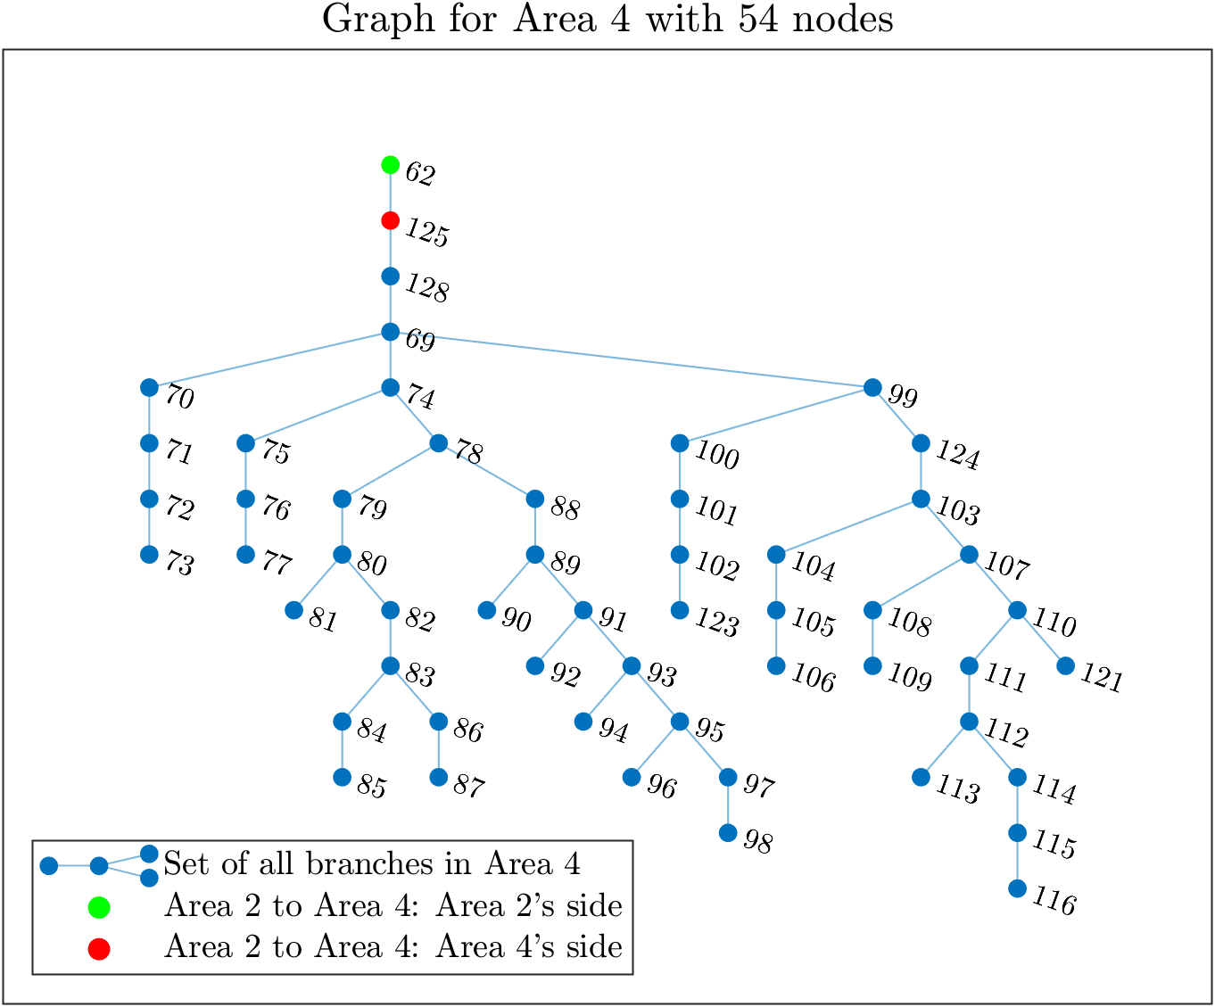
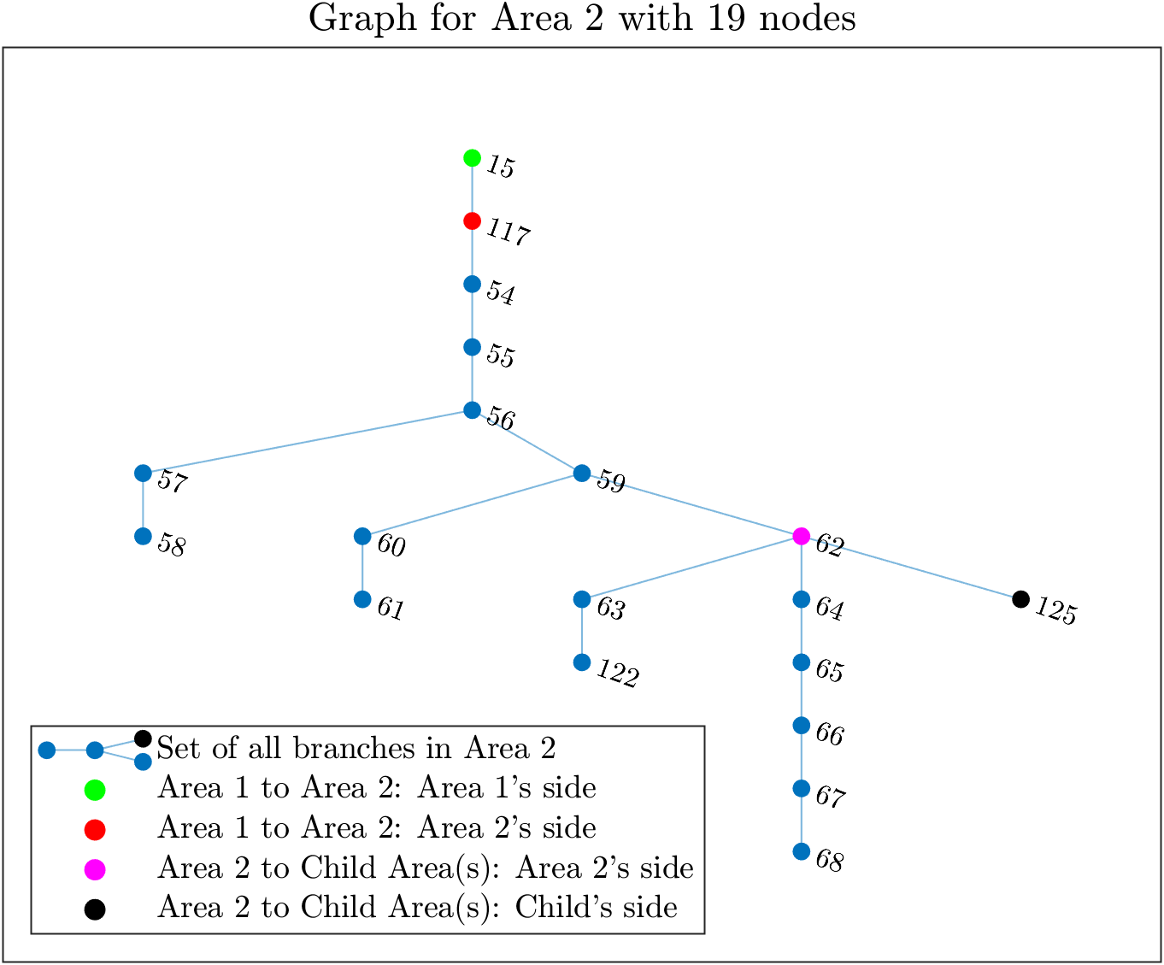
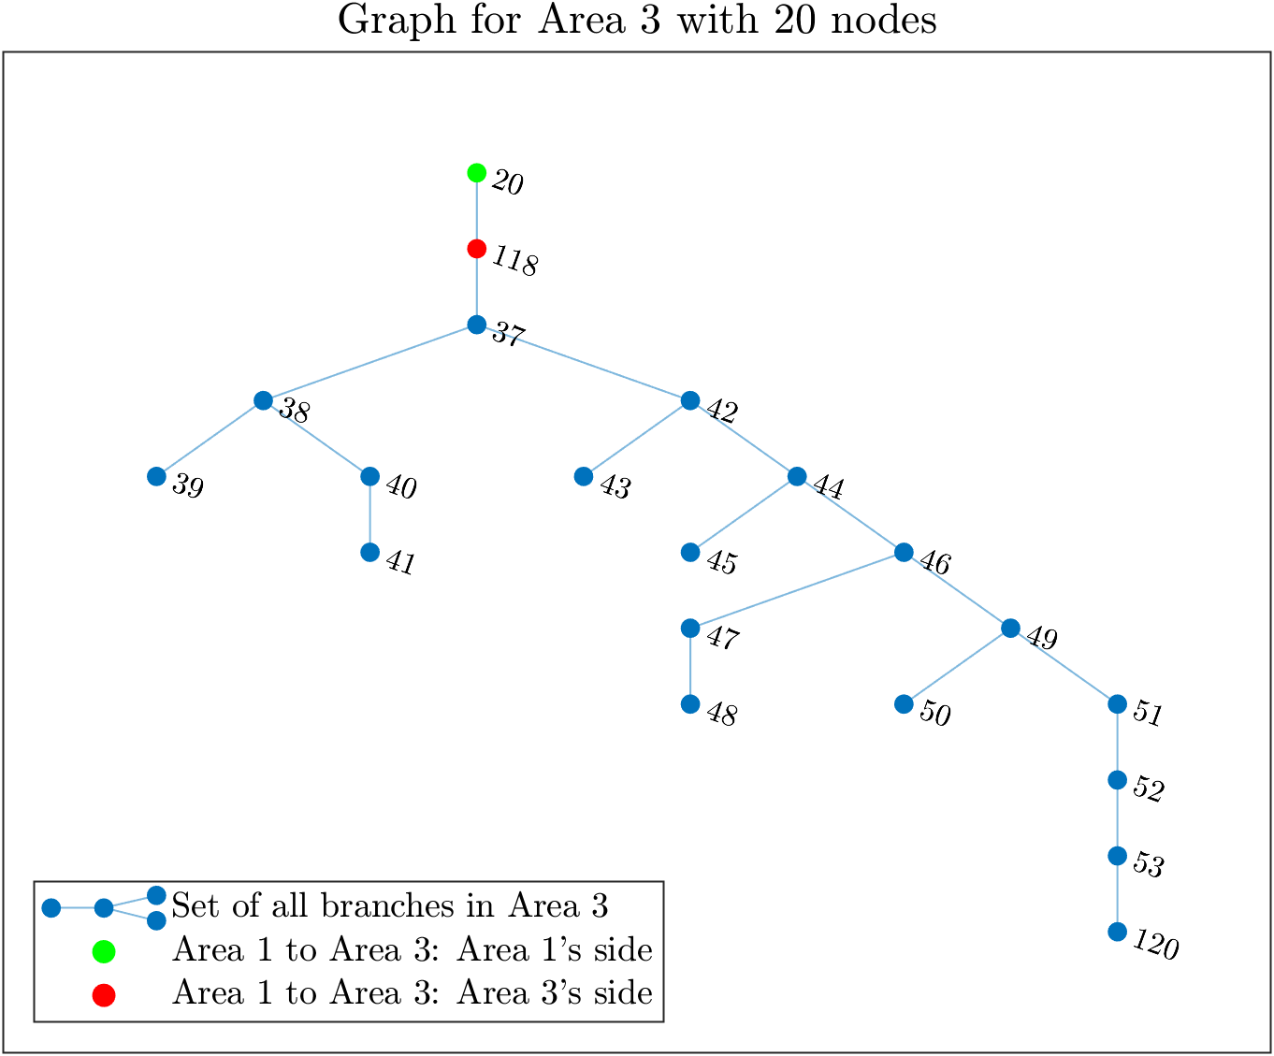
(IEEE 123 System divided into) 4 Area System

Slide 6
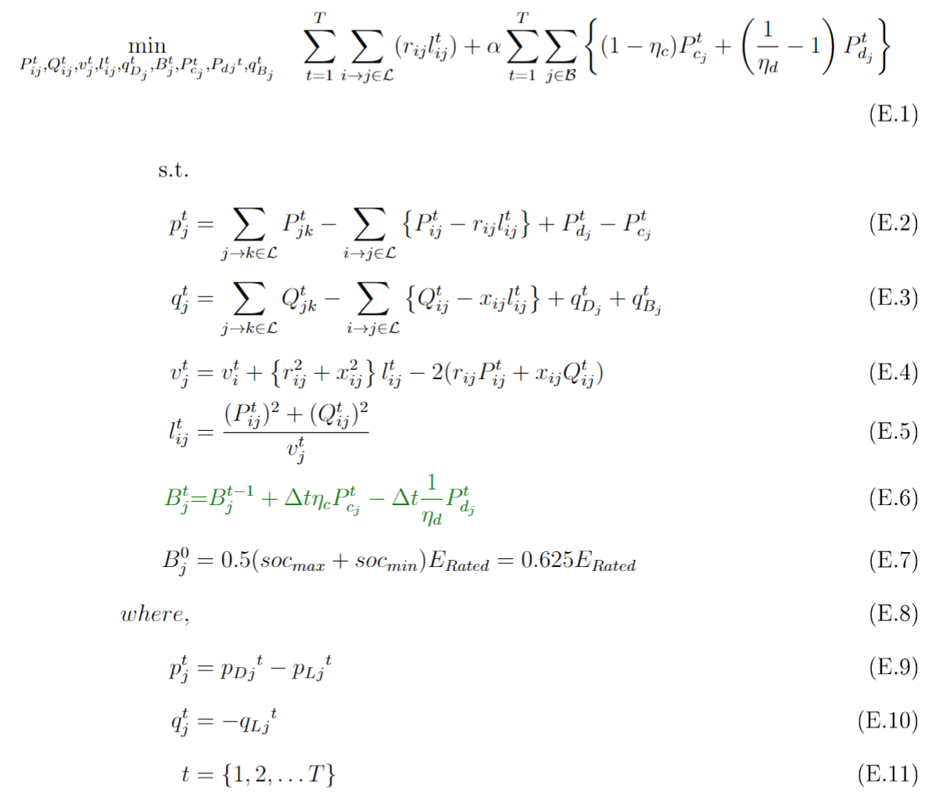
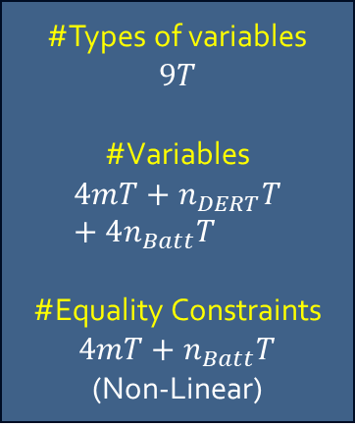
Optimization Formulation
The Full Optimization Problem for Brute-Force MPOPF
#Types of variables
$$9T$$
#Variables
$$4mT+n_{DERT}T+4n_{Batt}T$$
#Equality Constraints $4mT+n_{Batt}T$
(Non-Linear)

Slide 7
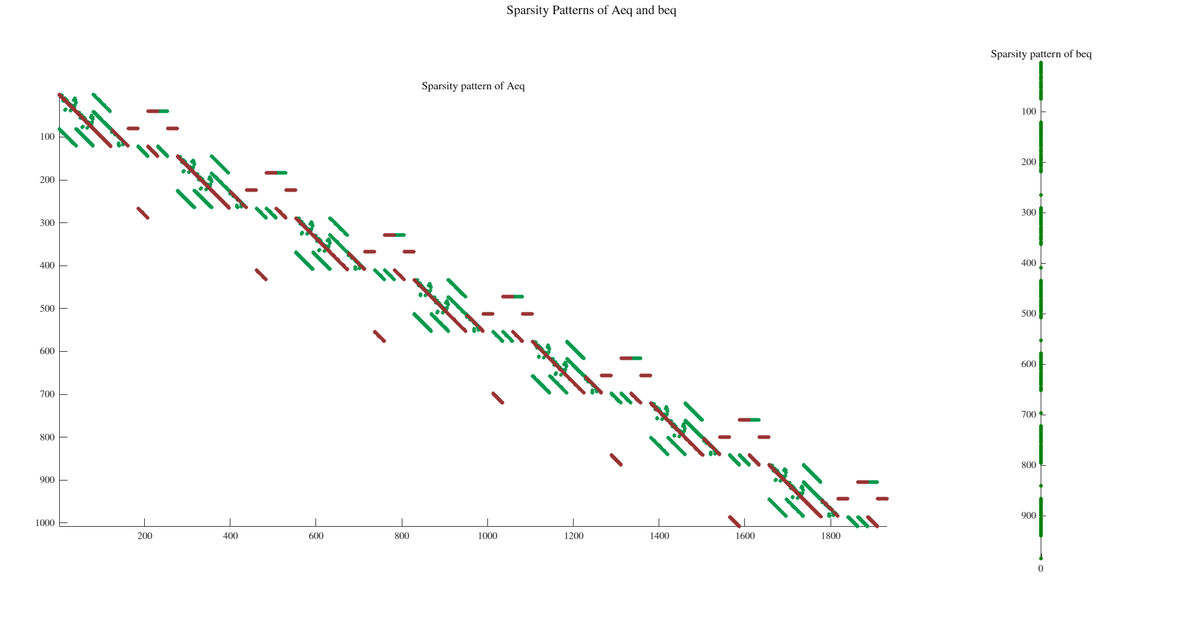

Optimization Formulation
The Full Optimization Problem for Brute-Force MPOPF
#Types of variables
$$9T$$
#Variables
$$4mT+n_{DERT}T+4n_{Batt}T$$
#Equality Constraints $4mT+n_{Batt}T$
(Non-Linear)

Slide 8
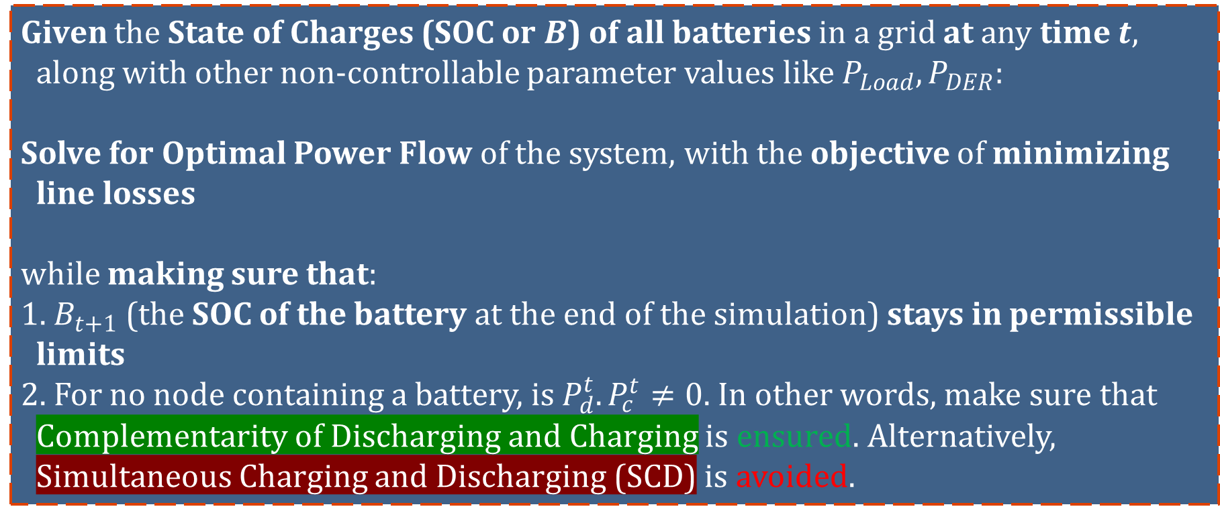
Problem Statement
Given the State of Charges (SOC or $B$) of all batteries in a grid at any time $t$, along with other non-controllable parameter values like $P_{Load}, P_{DER}$:
Solve for Optimal Power Flow of the system, with the objective of minimizing line losses
while making sure that:
1. $B_{t+1}$ (the SOC of the battery at the end of the simulation) stays in permissible limits
2. For no node containing a battery, is $P_{d}^{t}. P_{c}^{t}≠0$. In other words, make sure that Complementarity of Discharging and Charging is ensured. Alternatively, Simultaneous Charging and Discharging (SCD) is avoided.

Slide 9
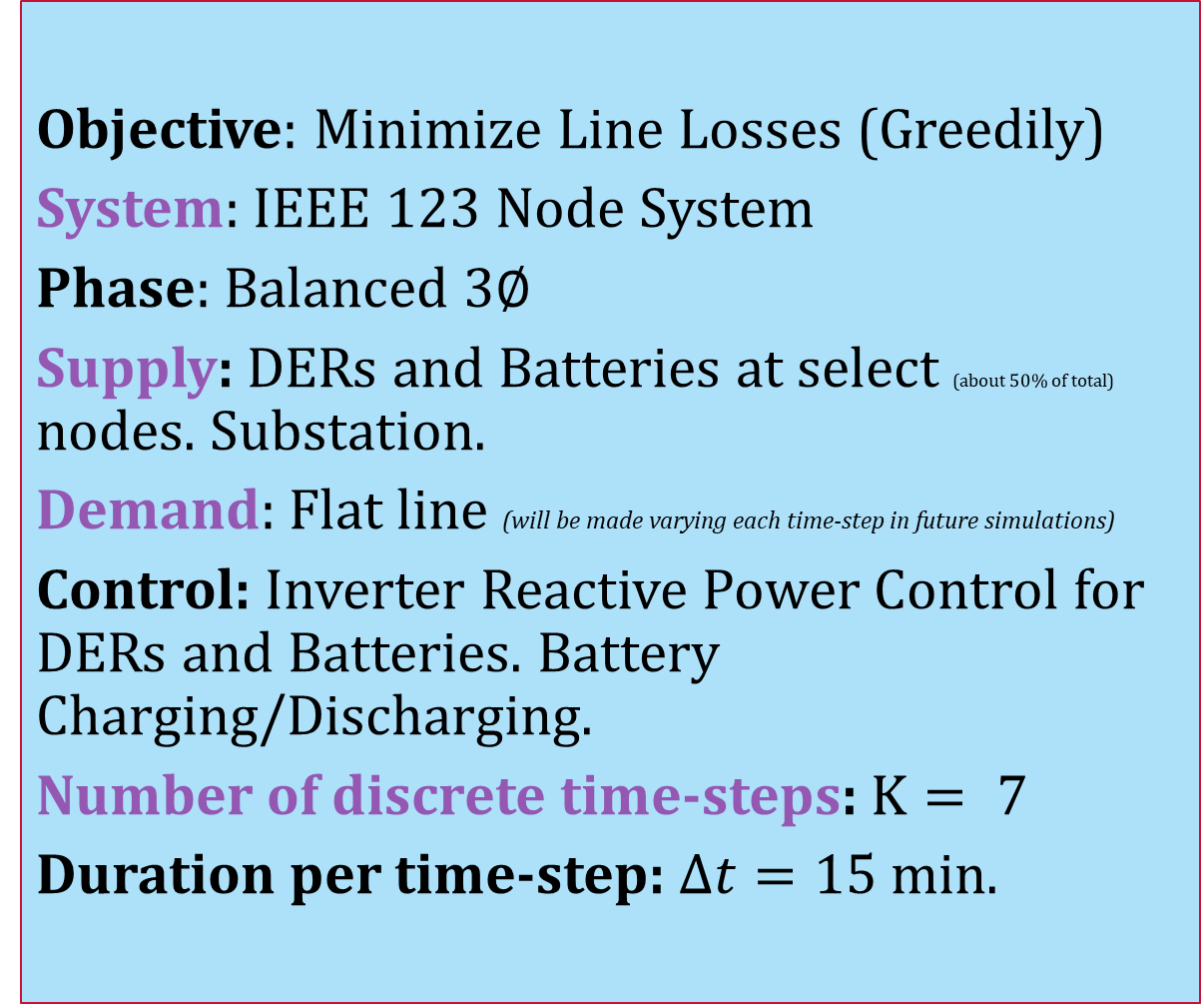
Simulation Parameters
Objective: Minimize Line Losses (Greedily)
System: IEEE $123$ Node System
Phase: Balanced $3∅$
Supply: DERs and Batteries at select (about $50\%$ of total) nodes. Substation.
Demand: Flat line (will be made varying each time-step in future simulations)
Control: Inverter Reactive Power Control for DERs and Batteries. Battery Charging/Discharging.
Number of discrete time-steps: $K= 7$
Duration per time-step: $Δt=15$min.

Slide 10
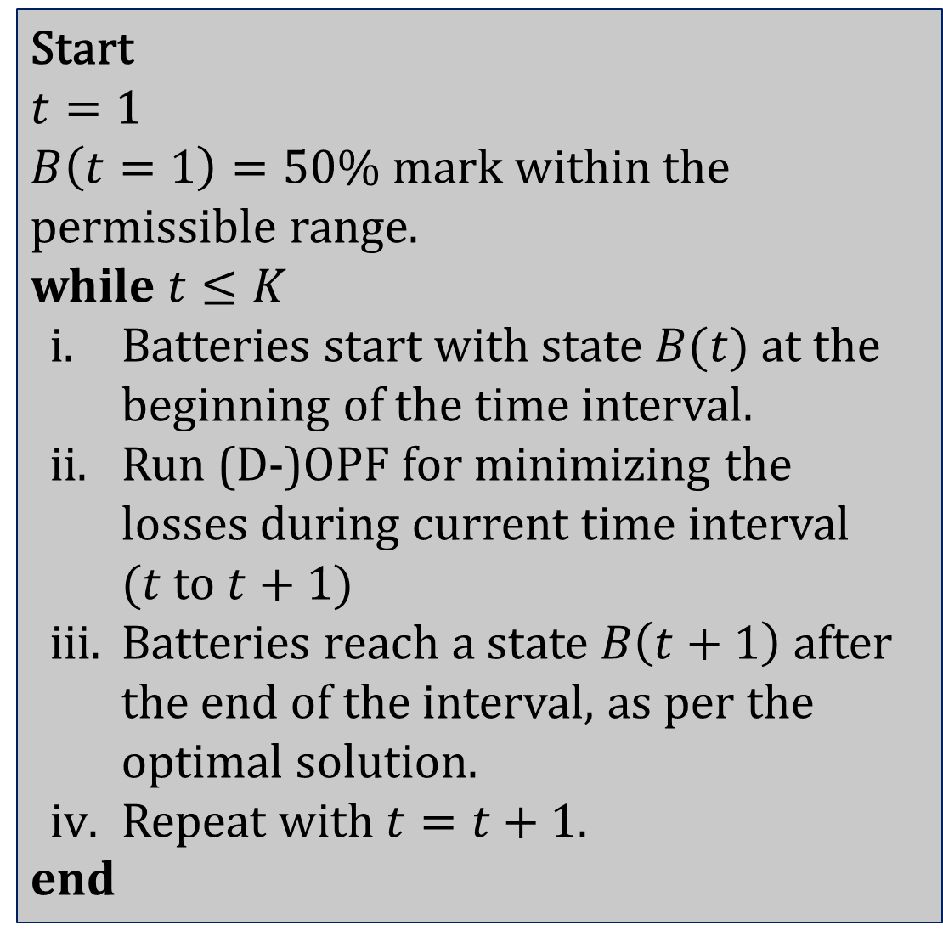
Simulation Process
Start
$$t=1$$
$B\left(t=1\right)=50\%$ mark within the permissible range.
while $t≤K$
Batteries start with state $B(t)$ at the beginning of the time interval.
Run (D-)OPF for minimizing the losses during current time interval $(t$to $t+1)$
Batteries reach a state $B\left(t+1\right)$ after the end of the interval, as per the optimal solution.
Repeat with $t=t+1$.
end

Slide 11
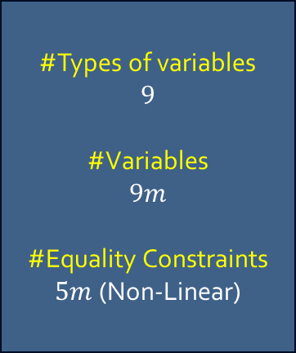
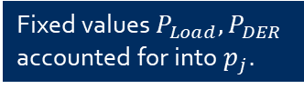
Optimization Formulation
Will happen when every node has a DER and a Battery
The Full Optimization Problem: Linear Objective, Non-Linear Constraint
SCD Term (Green Box)
Fixed values $P_{Load}, P_{DER}$ accounted for into $p_{j}$.
Most Complicated Scenario Possible
#Types of variables
$$9$$
#Variables
$$9m$$
#Equality Constraints $5m$ (Non-Linear)

Slide 12
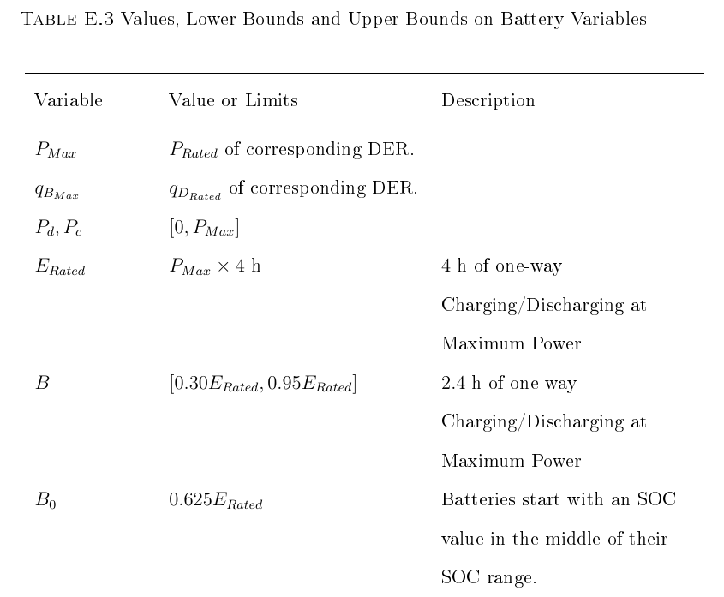
Bounds and Values
Battery State/Control Variables

Slide 13
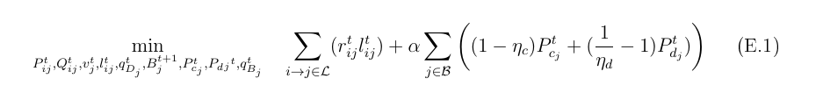
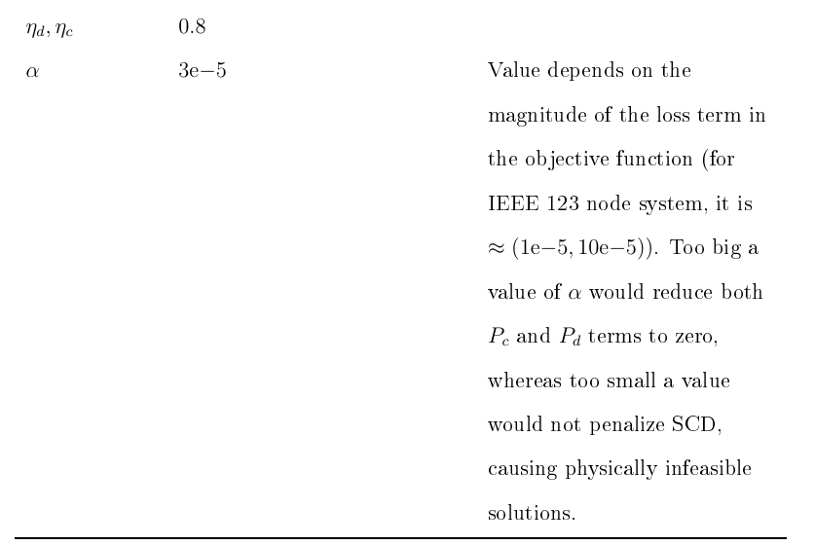
Bounds and Values
$α$ – The Coefficient for the Green Box term penalizing SCD

Slide 14
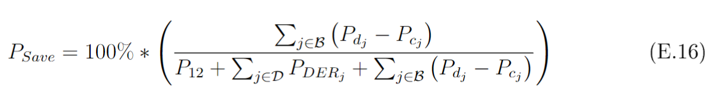
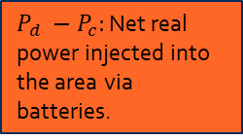
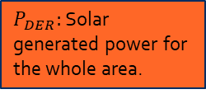
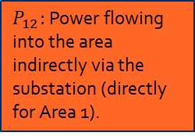
A metric for quantifying effect of storage and DER power on the grid.
$$P_{Save}$$
$P_{12}:$Power flowing into the area indirectly via the substation (directly for Area 1).
$P_{Save}↑ →$More savings in losses and substation power through batteries.
$P_{DER}:$Solar generated power for the whole area.
$P_{d} −P_{c}:$Net real power injected into the area via batteries.

Slide 15
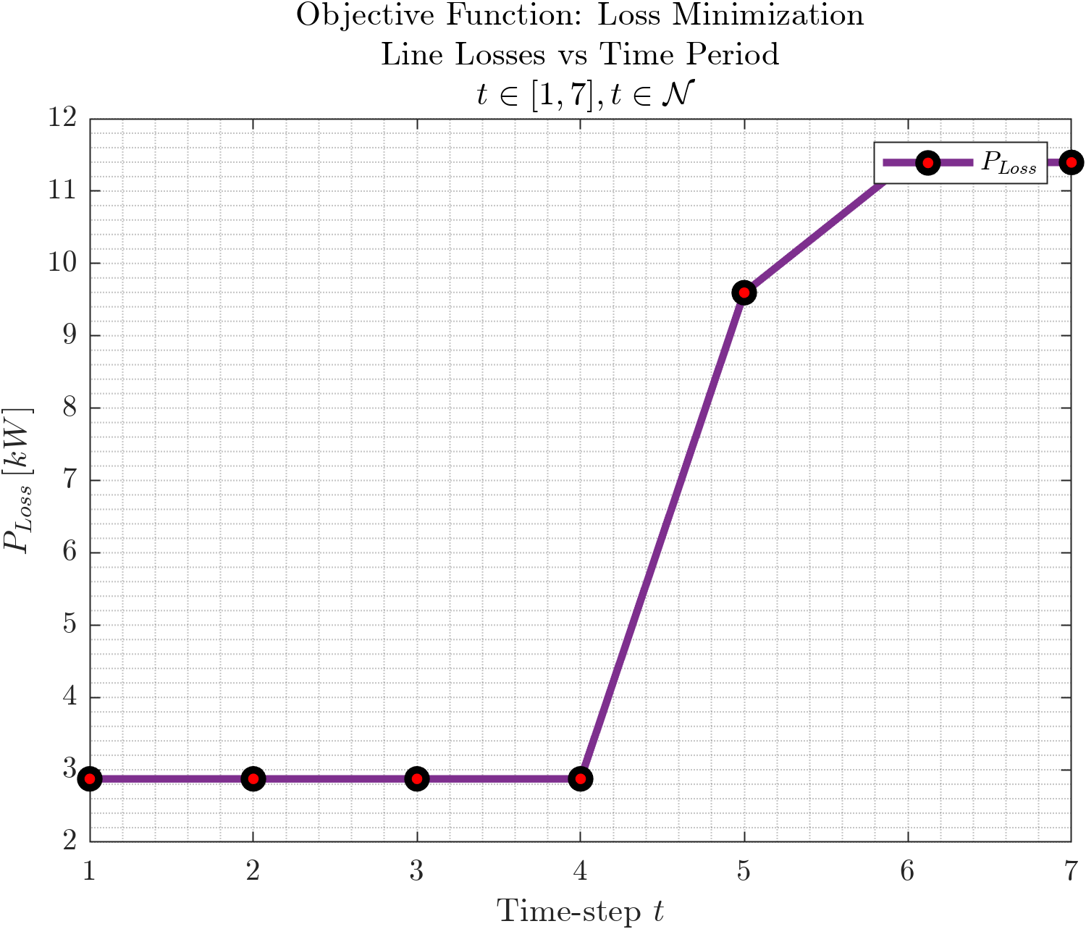
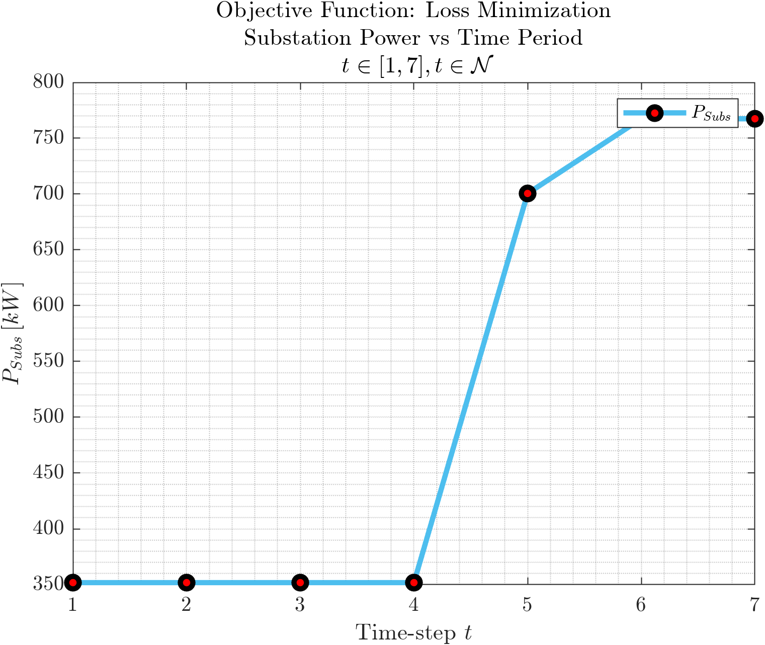
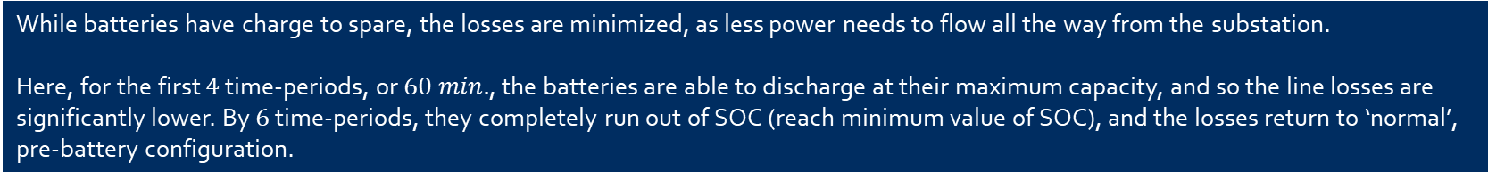
Results: Real Power Losses
$P_{Losses}, P_{Subs}$ vs $t$
While batteries have charge to spare, the losses are minimized, as less power needs to flow all the way from the substation.
Here, for the first $4$ time-periods, or $60 min.$, the batteries are able to discharge at their maximum capacity, and so the line losses are significantly lower. By $6$ time-periods, they completely run out of SOC (reach minimum value of SOC), and the losses return to ‘normal’, pre-battery configuration.

Slide 16
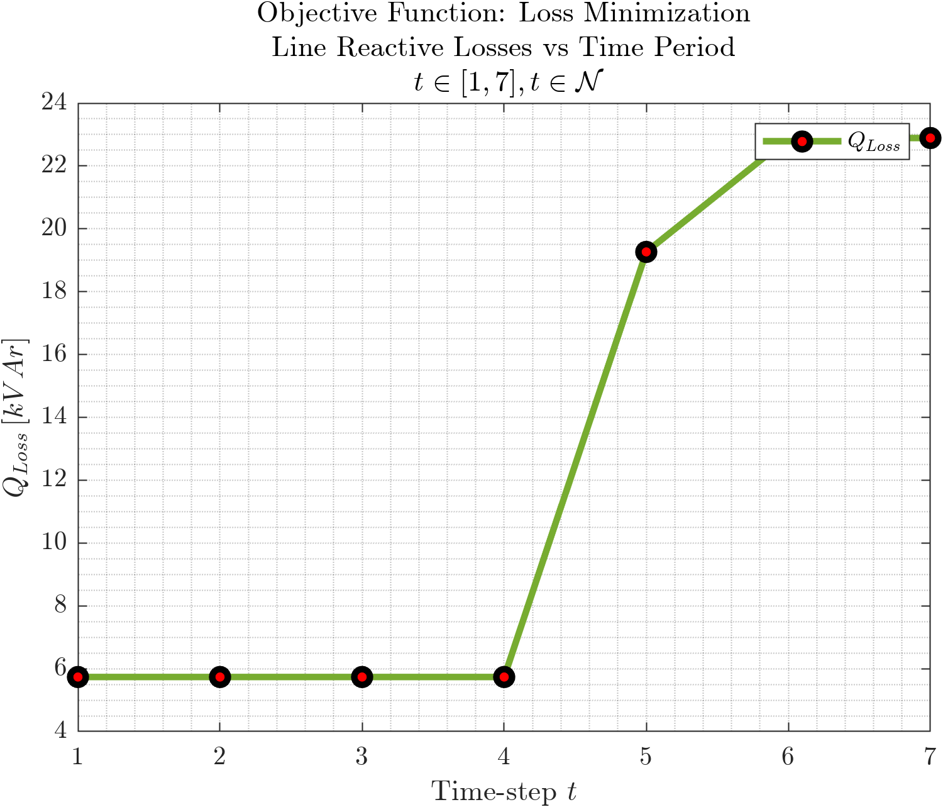
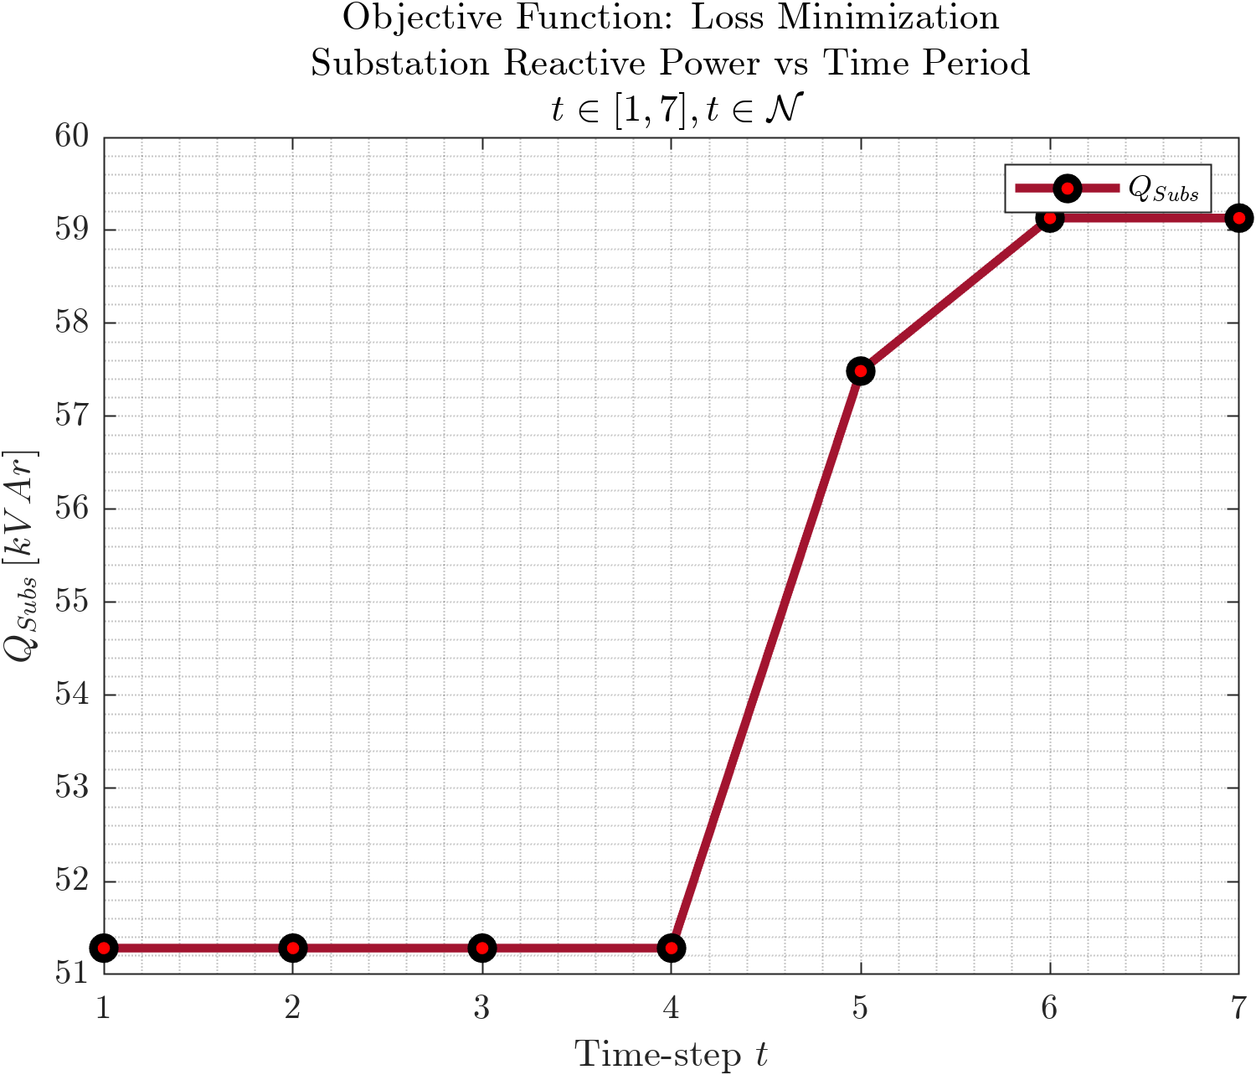
Results: Reactive Power Losses
$Q_{Losses}, Q_{Subs}$ vs $t$
Investigate further. I thought that since batteries don’t generate Real Power when they run out of SOC, they should generate more reactive power. I guess more real power flow is highly coupled with more reactive power flow? Need to check $q_{D_{j}}$ values.

Slide 17
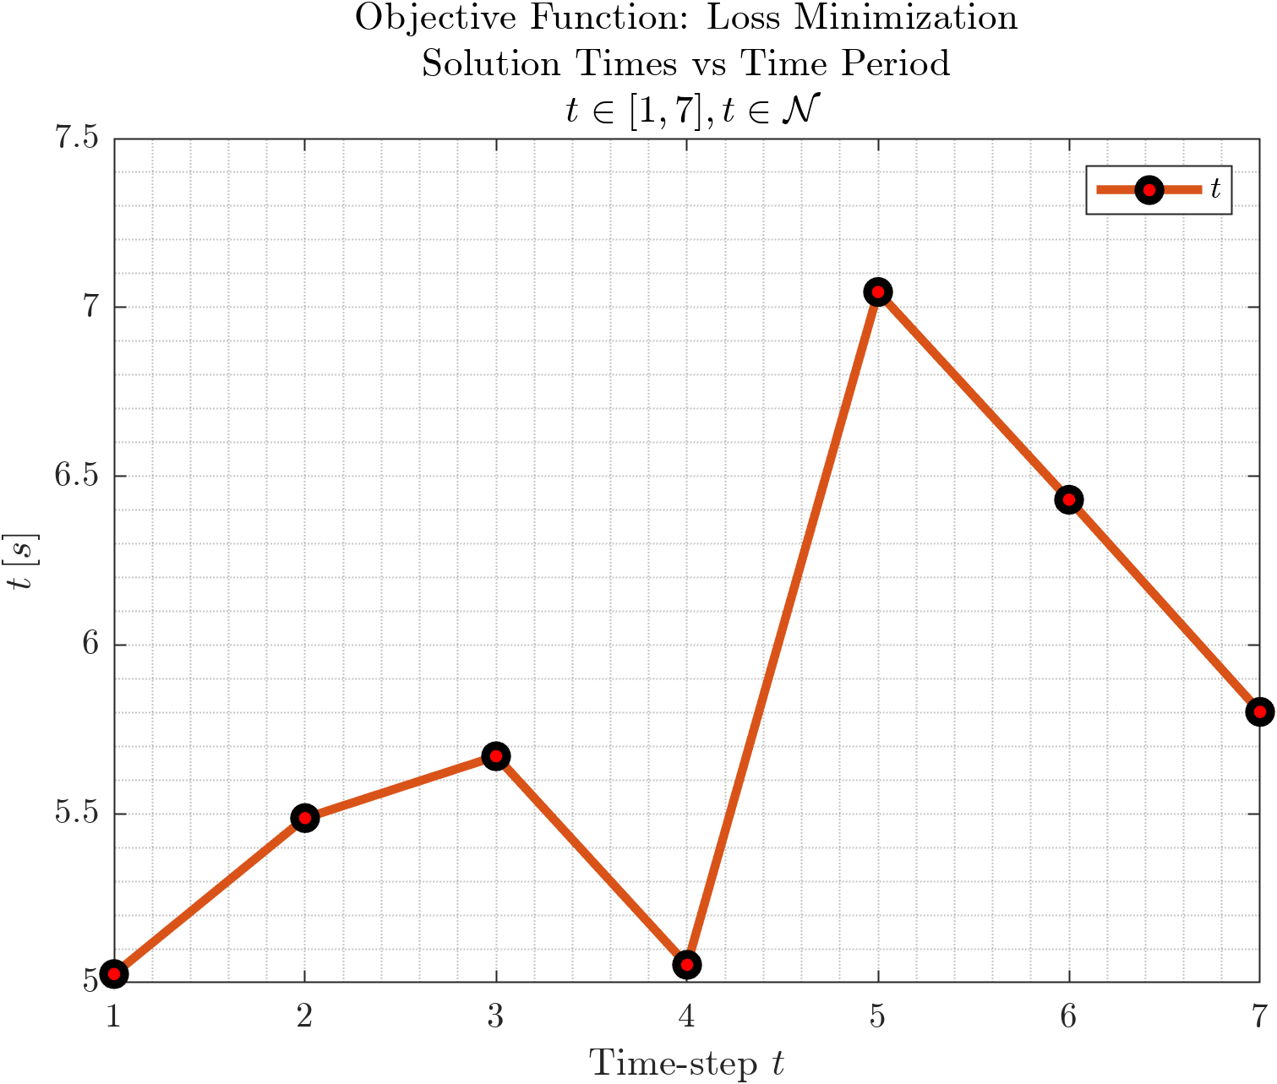
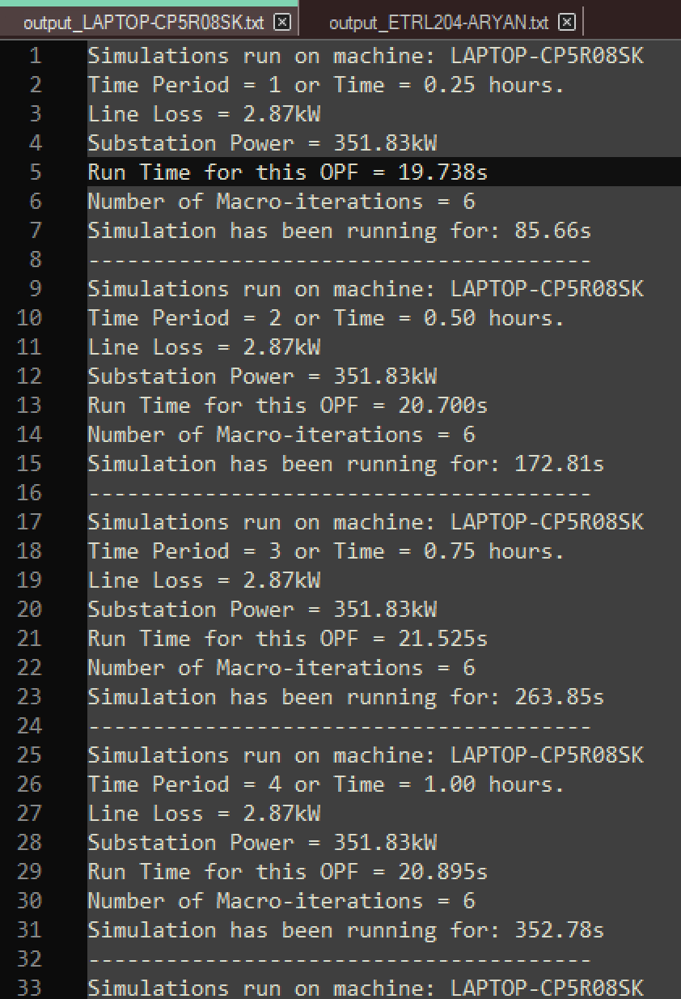
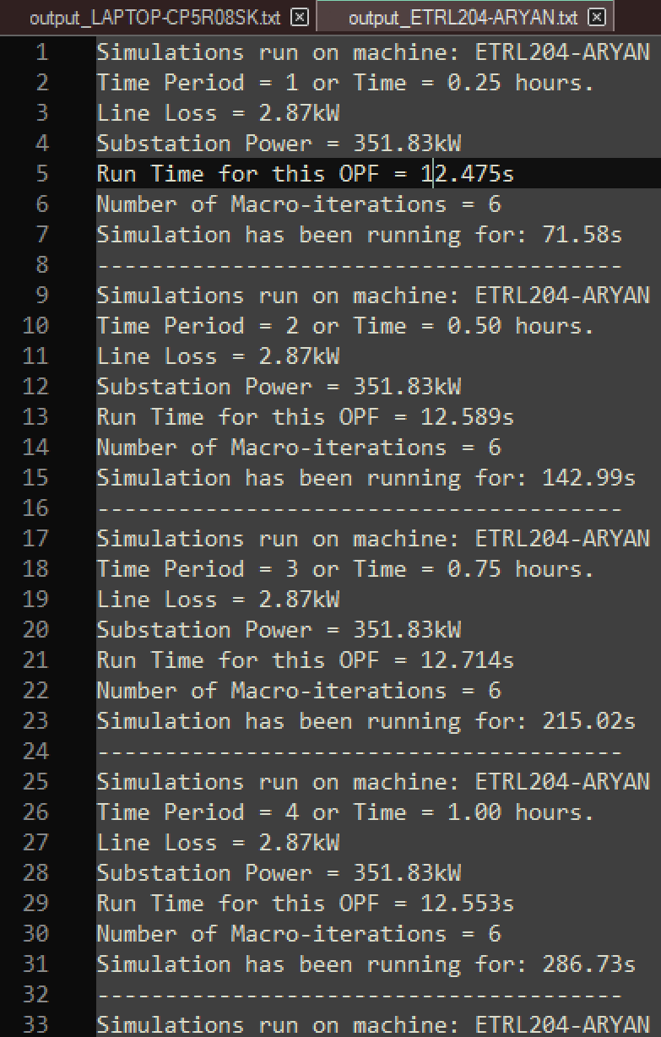
Results
$t_{Optimization}$ vs $t$
Machine dependent AND still varies every run.
To do: Clarify the values in the plot and the ones in the logs. How exactly are they different again?
My personal machine
My Lab machine

Slide 18
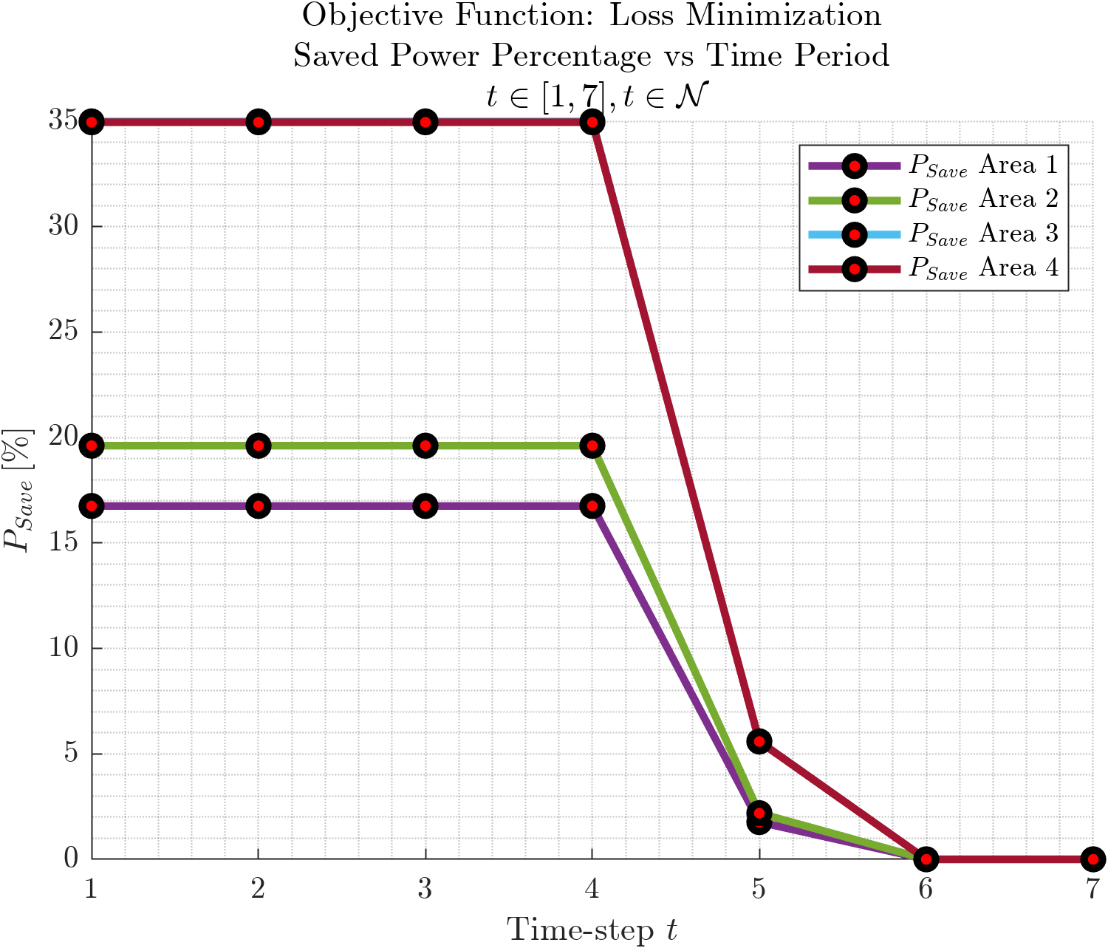
Results
$P_{Save}$ vs $t$

Slide 19
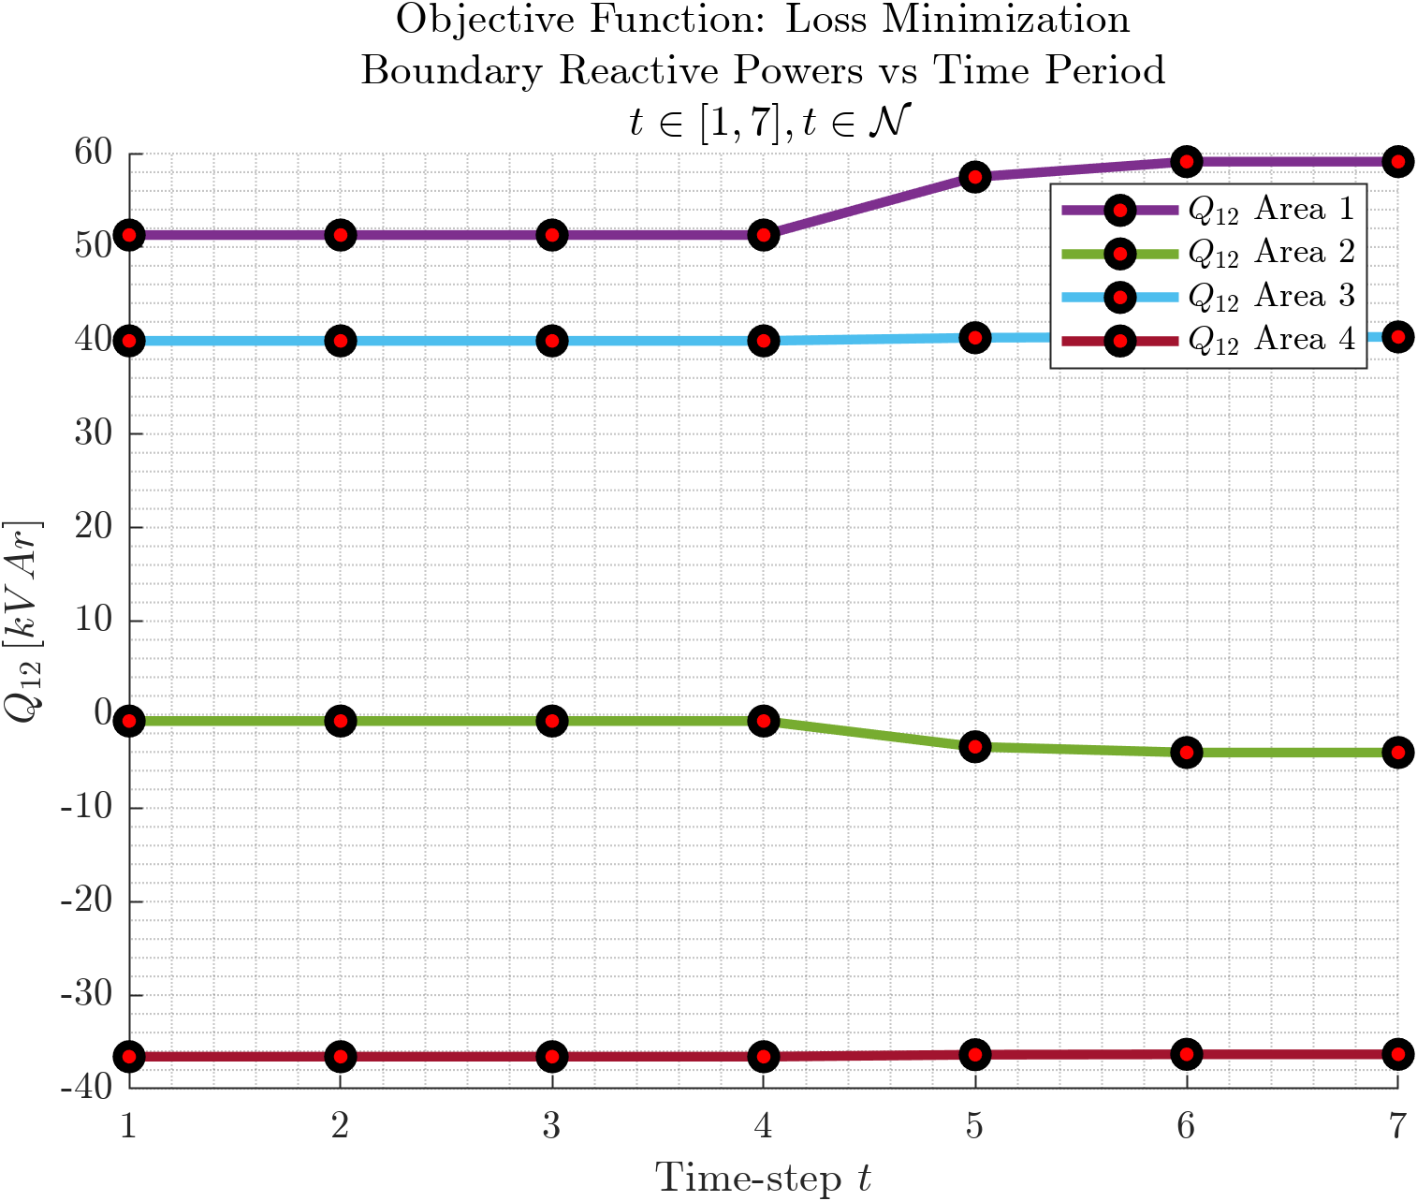
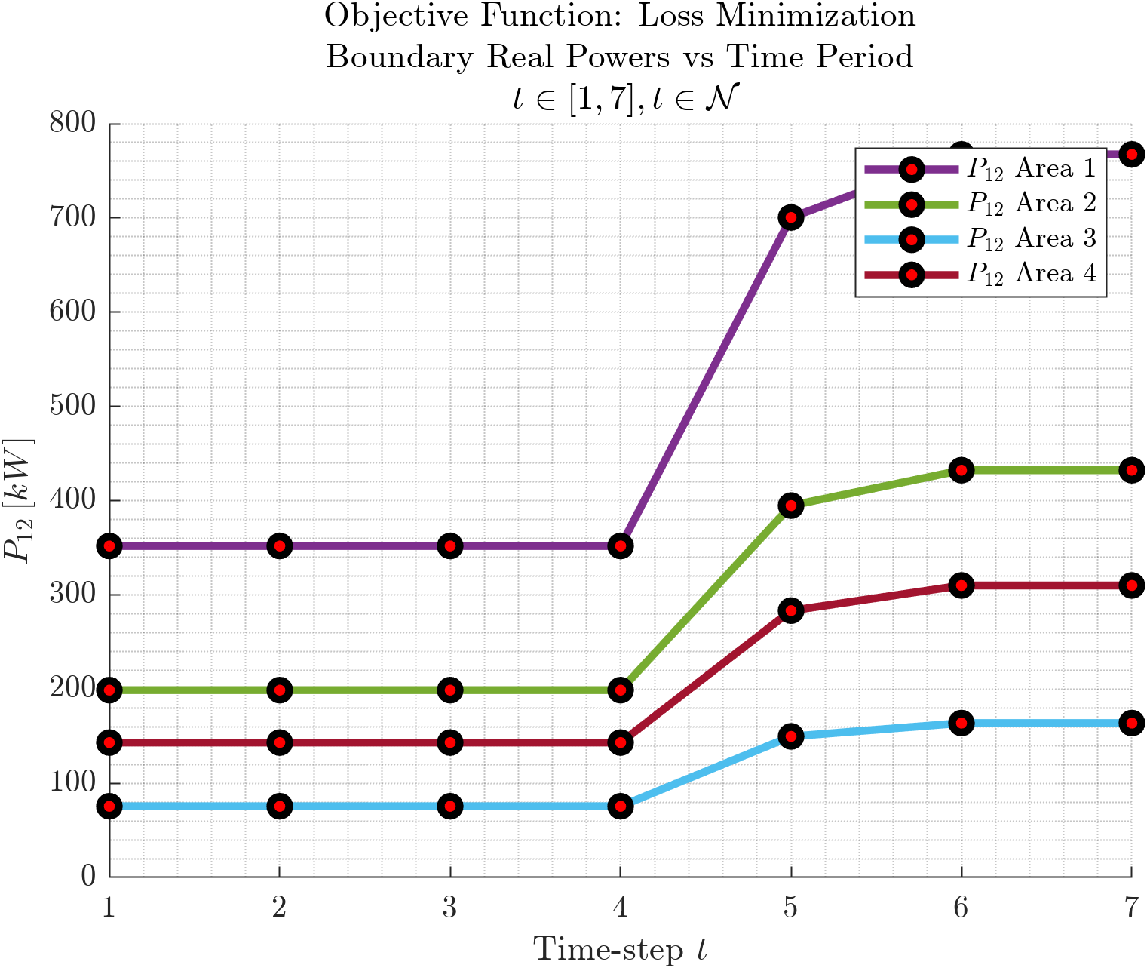
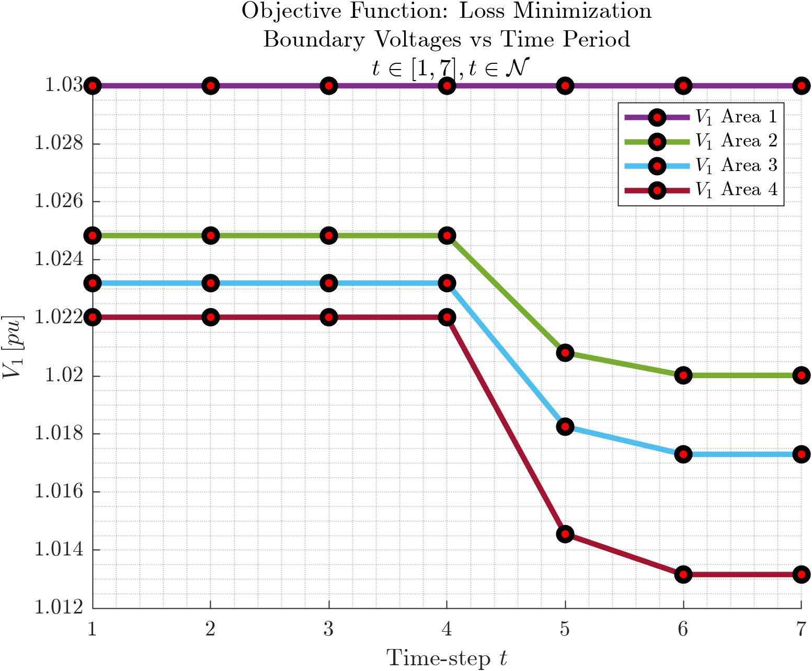
Results: Boundary Variables
$P_{12}, Q_{12}, V_{1}$ vs $t$
As expected.
Investigate: Negative Reactive Power Flowing from Area 1 to Area 3 and Area 2 to Area 4? Check reactive generation values for the areas.

Slide 20
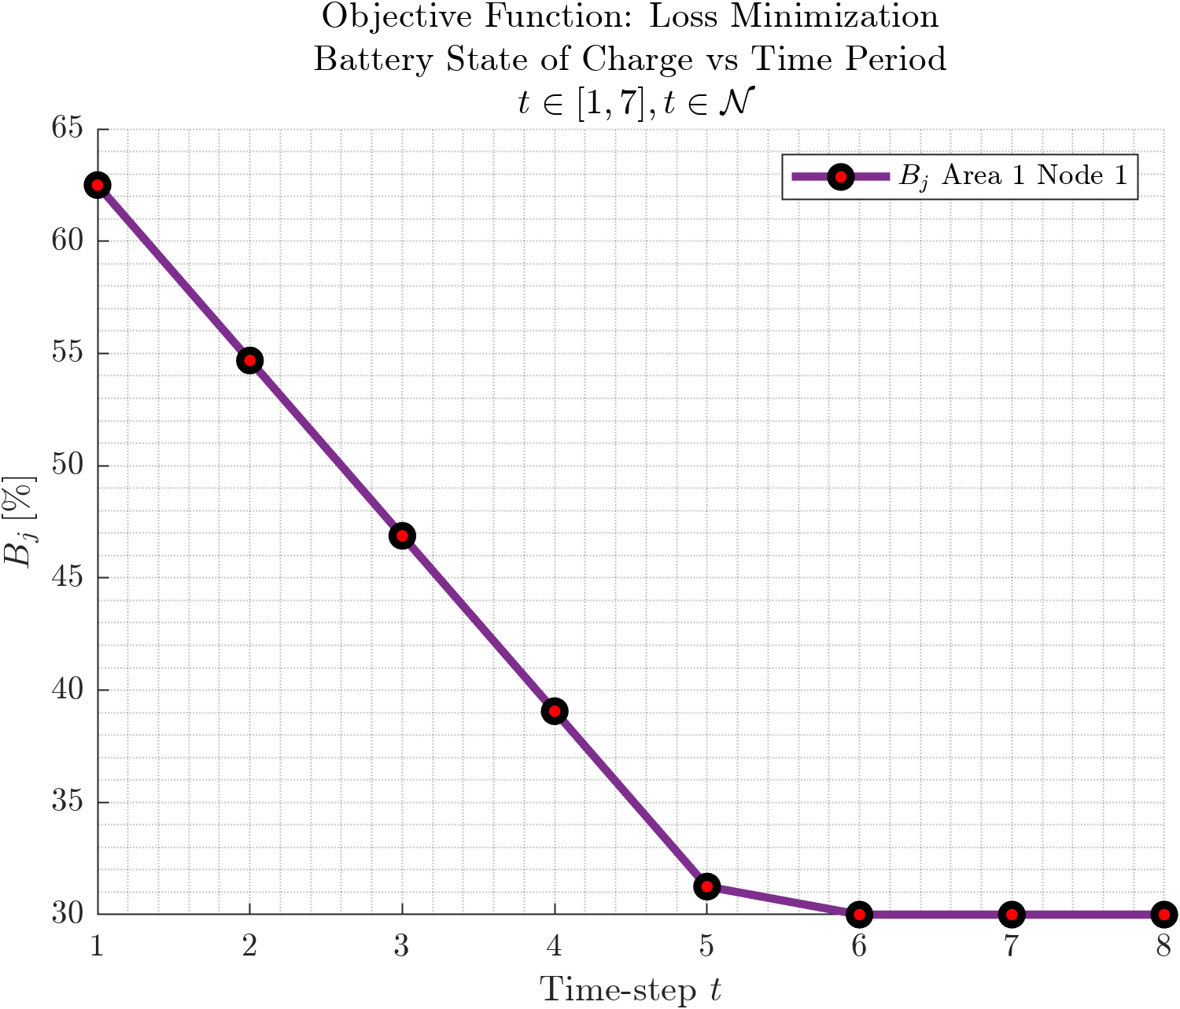
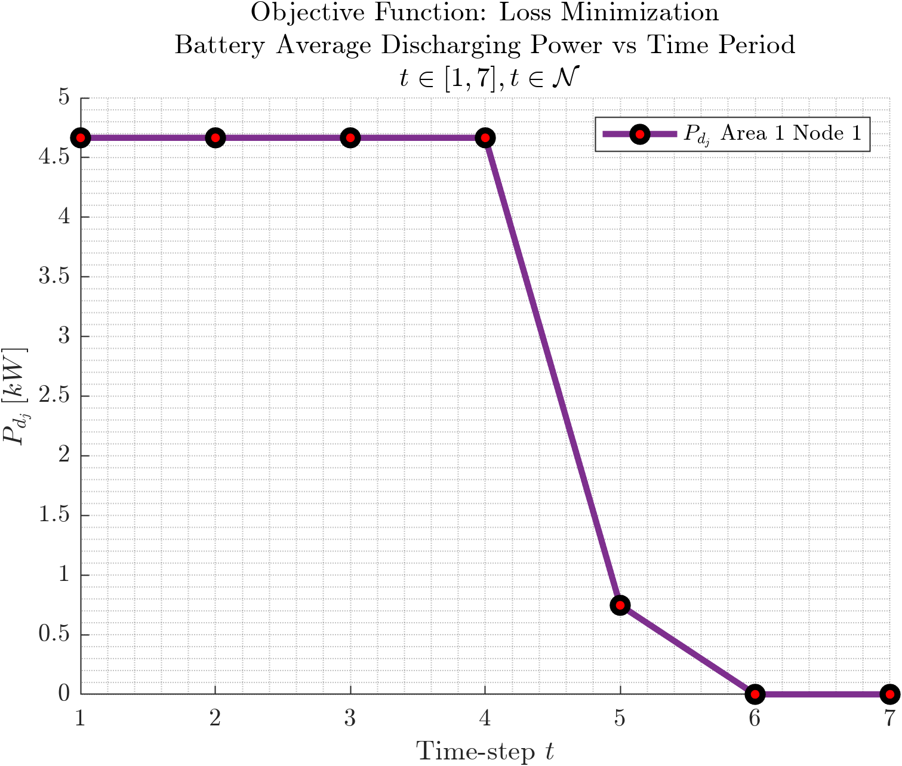
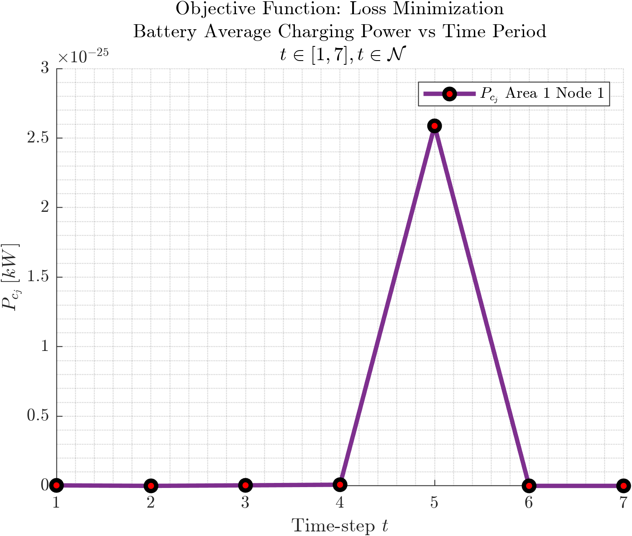
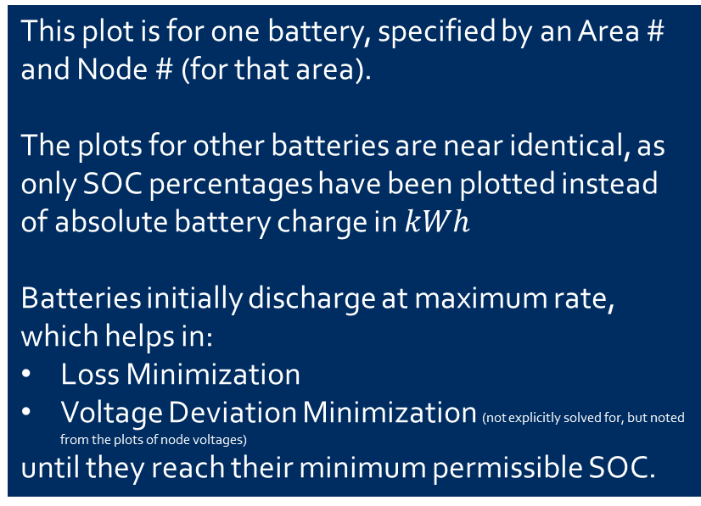
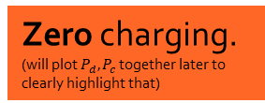
Results: Battery Variables
$B_{j}(t)$, $P_{c_{j}}, P_{c_{j}}$vs $t$
This plot is for one battery, specified by an Area $\#$ and Node $\#$ (for that area).
The plots for other batteries are near identical, as only SOC percentages have been plotted instead of absolute battery charge in $kWh$
Batteries initially discharge at maximum rate, which helps in:
Loss Minimization
Voltage Deviation Minimization (not explicitly solved for, but noted from the plots of node voltages)
until they reach their minimum permissible SOC.
Zero charging. (will plot $P_{d}, P_{c}$ together later to clearly highlight that)

Slide 21
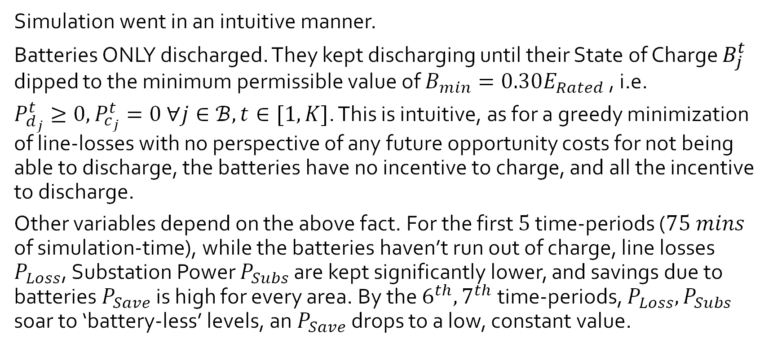
Results
Multi-Period D-OPF of IEEE $123$Node System
Simulation went in an intuitive manner.
Batteries ONLY discharged. They kept discharging until their State of Charge $B_{j}^{t}$ dipped to the minimum permissible value of $B_{min}=0.30E_{Rated}$ , i.e.
$P_{d_{j}}^{t}≥0, P_{c_{j}}^{t}=0 ∀j∈ℬ, t∈[1, K]$. This is intuitive, as for a greedy minimization of line-losses with no perspective of any future opportunity costs for not being able to discharge, the batteries have no incentive to charge, and all the incentive to discharge.
Other variables depend on the above fact. For the first $5$ time-periods ($75 mins$ of simulation-time), while the batteries haven’t run out of charge, line losses $P_{Loss}$, Substation Power $P_{Subs}$ are kept significantly lower, and savings due to batteries $P_{Save}$ is high for every area. By the $6^{th}, 7^{th}$time-periods, $P_{Loss}, P_{Subs}$ soar to ‘battery-less’ levels, an $P_{Save}$ drops to a low, constant value.

Slide 22
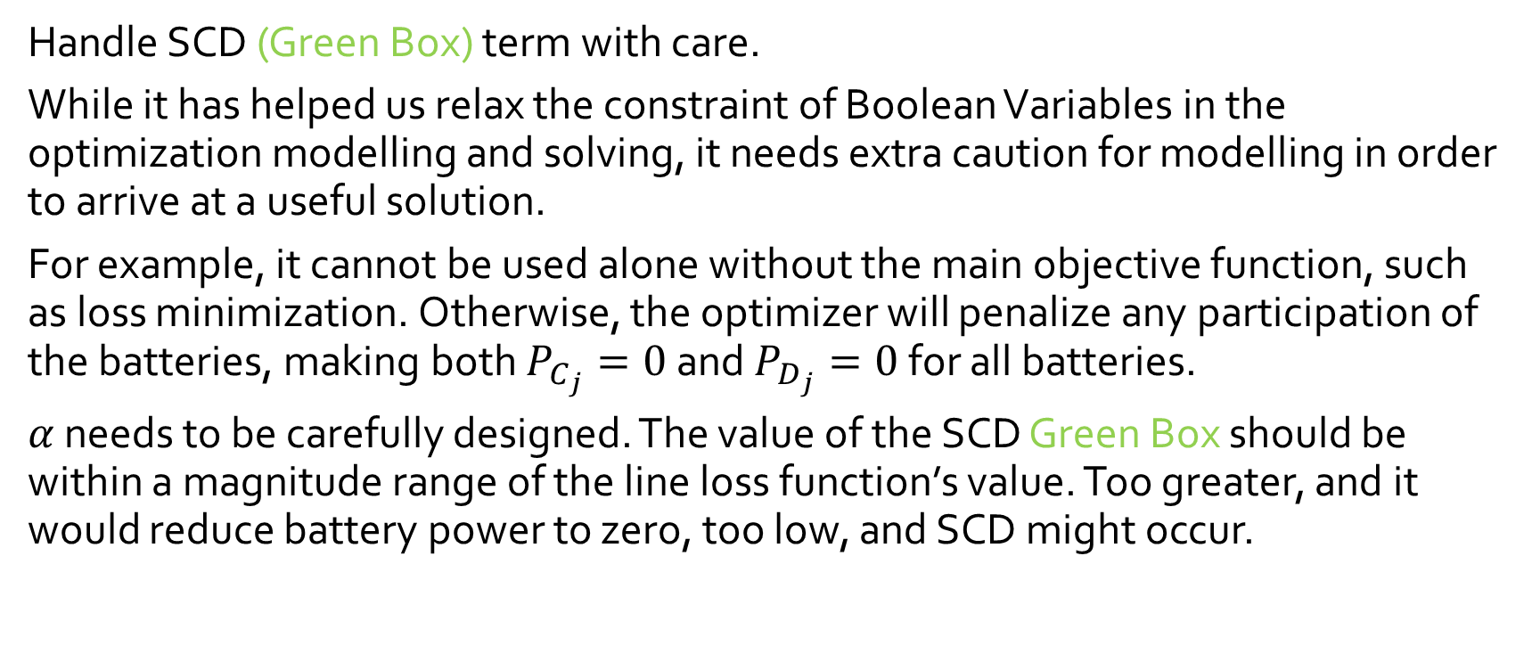
Takeaways
The cost of replacing the Boolean Constraints with the SCD Green Box term for avoiding SCD.
Handle SCD (Green Box) term with care.
While it has helped us relax the constraint of Boolean Variables in the optimization modelling and solving, it needs extra caution for modelling in order to arrive at a useful solution.
For example, it cannot be used alone without the main objective function, such as loss minimization. Otherwise, the optimizer will penalize any participation of the batteries, making both $P_{C_{j}}=0$and $P_{D_{j}}=0$for all batteries.
$α$ needs to be carefully designed. The value of the SCD Green Box should be within a magnitude range of the line loss function’s value. Too greater, and it would reduce battery power to zero, too low, and SCD might occur.

Slide 23
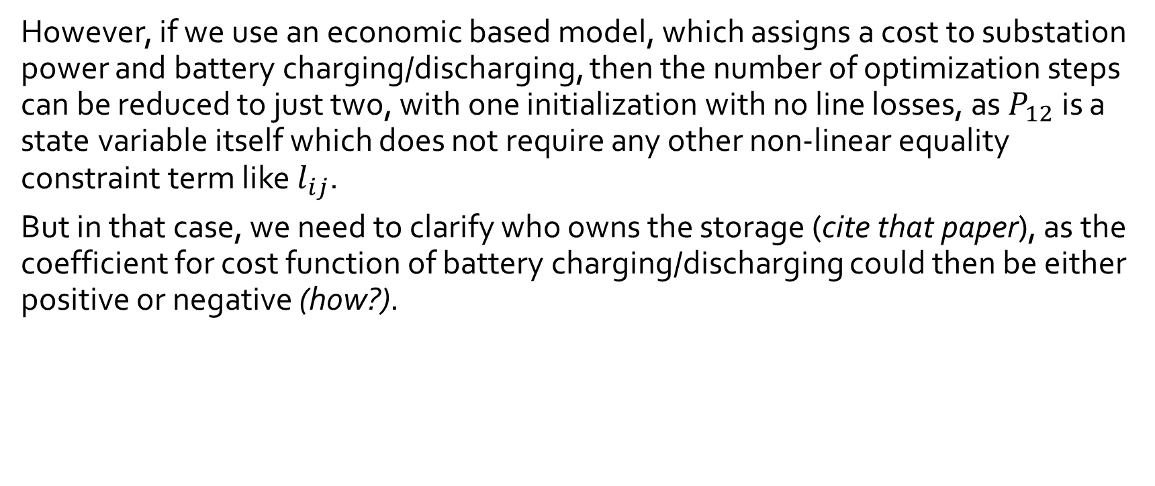
Takeaways
The cost of replacing the Boolean Constraints with the SCD Green Box term for avoiding SCD.
However, if we use an economic based model, which assigns a cost to substation power and battery charging/discharging, then the number of optimization steps can be reduced to just two, with one initialization with no line losses, as$P_{12}$ is a state variable itself which does not require any other non-linear equality constraint term like $l_{ij}$.
But in that case, we need to clarify who owns the storage (cite that paper), as the coefficient for cost function of battery charging/discharging could then be either positive or negative (how?).

Slide 24
Reference of Notation

Slide 25
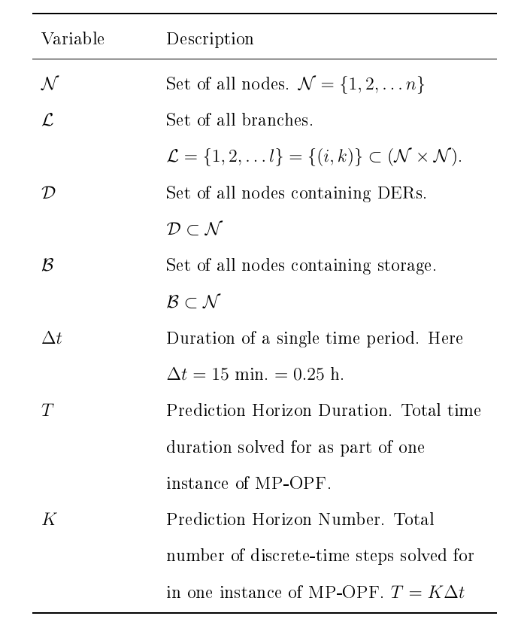
Reference of Notation
Helpful for clarifying any variable in the optimization formulations.

Slide 26
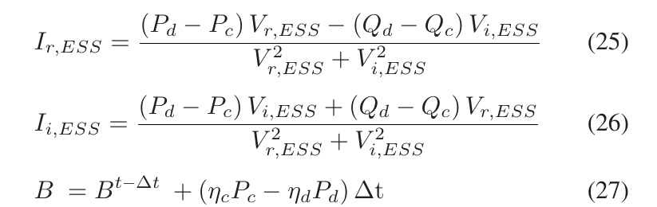
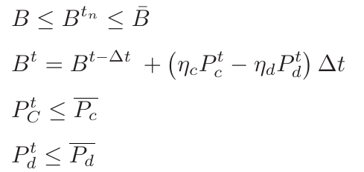
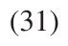
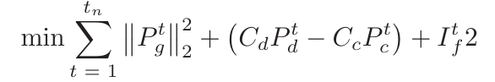
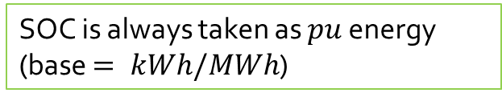
Battery Models Used in Various Papers
SOC is always taken as $pu$ energy (base $= kWh/MWh$)
Large Scale Multi-Period Optimal Power Flow With Energy Storage Systems Using Differential Dynamic Programming
Ensures Complementarity (i.e., ensures absence of SCD) without any additional boolean constraints.
They prefer rectangular coordinates for all complex variables, for usage in Newton Raphson method.

Slide 27
Battery Models Used in Various Papers
Large Scale Multi-Period Optimal Power Flow With Energy Storage Systems Using Differential Dynamic Programming
All variables are Continuous
No Discrete variables
No Boolean variables
In the final equations

Slide 28
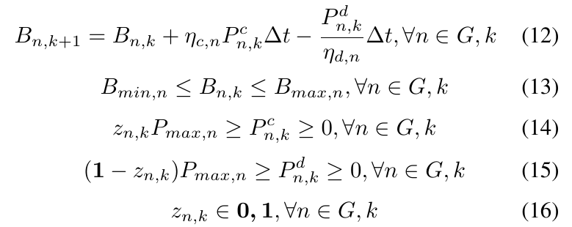
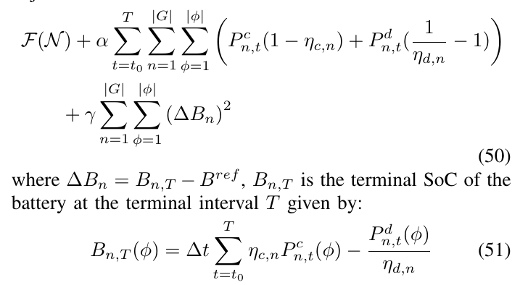
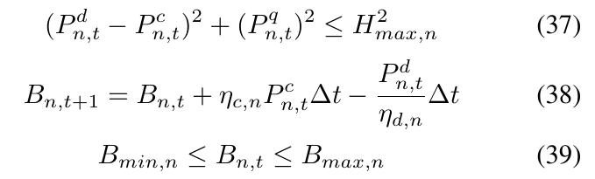
Battery Models Used in Various Papers
Receding-Horizon Optimization of Unbalanced Distribution Systems with Time-Scale Separation for Discrete and Continuous Control Devices
Two Optimization Loops (Time-scales): An ‘Outer’, slower MILP loop for fixing battery SOC values and STL element values.
An ‘Inner’, faster SOCP loop for solving for optimal power flows.
Battery apparent power (through inverter) limits.

Slide 29
Battery Models Used in Various Papers
Receding-Horizon Optimization of Unbalanced Distribution Systems with Time-Scale Separation for Discrete and Continuous Control Devices
Two Optimization Loops (Time-scales): An ‘Outer’, slower MILP loop for fixing battery SOC values and STL element values.
An ‘Inner’, faster SOCP loop for solving for optimal power flows.
Battery apparent power (through inverter) limits.

Slide 30

Battery Models Used in Various Papers
Upon addition of the green block, the grey terms are removed from the constraints.
Receding-Horizon Optimization of Unbalanced Distribution Systems with Time-Scale Separation for Discrete and Continuous Control Devices
The yellow block ensures that the terminal battery SOC value (i.e. SOC value at the end of the horizon) prescribed by the outer loop is adhered to.
$P_{n}^{q},_{t}$ is also an optimization (control) variable

Slide 31
Battery Models Used in Various Papers
Receding-Horizon Optimization of Unbalanced Distribution Systems with Time-Scale Separation for Discrete and Continuous Control Devices
All variables are Continuous
No Discrete variables
No Boolean variables
In the final equations

Slide 32
Battery Models Used in Various Papers
Battery models themselves are the same.
Optimal Multi-Period Dispatch of Distributed Energy Resources in Unbalanced Distribution Feeders
Also, NO yellow term this time.
For a system WITHOUT any STL elements, instead of a (MI , SOCP) loops, they use (SOCP, NLP) loops.
All variables are Continuous
No Discrete variables
No Boolean variables
In the final equations

Slide 33

Battery Models Used in Various Papers
Battery models themselves are the same.
Optimal Multi-Period Dispatch of Distributed Energy Resources in Unbalanced Distribution Feeders
Also, NO yellow term this time.
For a system WITHOUT any STL elements, instead of a (MI , SOCP) loops, they use (SOCP, NLP) loops.
All variables are Continuous
No Discrete variables
No Boolean variables
In the final equations

Slide 34

Battery Models Used in Various Papers
Battery Dispatching for End Users With On-Site Renewables and Peak Demand Charges – An Approximate Dynamic Programming Approach
Initial thoughts: It uses a linear/linearized model of the battery, and all equations are expressed with matrices.
Details to be added later.

